Slide 1

The Hitchhiker’s
Guide to the Cosmos
Chad Green
[Event Name]
[Event Date]

Slide 2


Who is Chad Green
Director of Software Development
ScholarRx
→ chadgreen@chadgreen.com
 chadgreen.com
 ChadGreen
 ChadwickEGreen

Slide 3

What is Cosmos DB

Slide 4

Azure Cosmos DB
A globally distributed, massively scalable, multi-model database service
Turnkey global distribution
Notes:
Turnkey Global Distribution
Enables you to build highly responsive and highly available applications worldwide
Transparently replicates your data wherever your users are, so your users can interact with a replica of the data that is closest to them
Add or remove any of the Azure regions to your Cosmos account at any time, with a click of a button
Cosmos DB will seamlessly replicate your data to all the regions associated with your account while your application continues to be highly available, thanks to the multi-homing capabilities
Always On
By virtue of deep integration with Azure infrastructure and transparent multi-master replication, Cosmos DB provides 99.999% high availability for both reads and writes.
Provides you the ability to programmatically or via Portal invoke the regional failover of your Cosmos account
Helps ensure that your application is designed to failover in the case of regional disaster

Slide 5
Azure Cosmos DB
A globally distributed, massively scalable, multi-model database service
Comprehensive SLAs
Turnkey global distribution
Turnkey global distribution
Notes:
Industry Leading Comprehensive SLAs
First and only service to offer industry-leading comprehensive SLAs encompassing 5-nine availability, read and write latency at the 99th percentile, guaranteed throughput, and consistency.

Slide 6
Azure Cosmos DB
A globally distributed, massively scalable, multi-model database service
Comprehensive SLAs
Elastic scale out
of storage & throughput
Turnkey global distribution
Comprehensive SLAs
Notes:
Elastic scalability of throughput and storage, worldwide
Designed with transparent horizontal partitioning and multi-master replication
Offers unprecedent elastic scalability for your writes and reads, all around the globe
Elastically scale up from thousands to hundreds of millions of requests per second around the global with a single API call and pay only for the throughput (and storage) you need
Helps you deal with unexpected spikes in your workloads without having to over-provision for the peak

Slide 7
Azure Cosmos DB
A globally distributed, massively scalable, multi-model database service
Guaranteed low latency at the 99th percentile
Elastic scale out
of storage & throughput
Elastic scale out
of storage & throughput
Turnkey global distribution
Comprehensive SLAs
Notes:
Guaranteed low latency at 99th percentile, worldwide
Using Cosmos DB, you can build highly responsive, planet scale applications
With its novel multi-master replication protocol and latch free and write-optimized database engine, Cosmos guarantees less than 10-ms latencies for both, reads (indexed) and writes at 99th percentile, all around the world
Capability ensures sustained ingestion of data and blazing-fast queries for highly responsive apps

Slide 8
Azure Cosmos DB
A globally distributed, massively scalable, multi-model database service
Guaranteed low latency at the 99th percentile
Five well-defined consistency models
Elastic scale out
of storage & throughput
Guaranteed low latency at the 99th percentile
Turnkey global distribution
Comprehensive SLAs
Notes:
Precisely defined, multiple consistency choices
No longer have to make extreme tradeoffs between consistency, availability, latency, and throughput
Cosmos DB’s multi-master replication protocol is carefully designed to offer five well-defined consistency choices for an intuitive programming model with low latency and high availability for your globally distributed application
SLA guarantee that 100% of read requests meet the consistency for any consistency level you choose

Slide 9
Azure Cosmos DB
A globally distributed, massively scalable, multi-model database service
Eventual
Consistent Prefix
Session
Bounded Staleness
Strong
Five well-defined consistency models
Elastic scale out
of storage & throughput
Guaranteed low latency at the 99th percentile
Turnkey global distribution
Comprehensive SLAs
Notes:
Strong
Strong Consistency provides the most predictable and intuitive programming model. When you configure your account with strong consistency level, Azure Cosmos DB provides linearizability guarantee.
This means that reads are guaranteed to see the most recent write.
Offers a linearizability guarantee
Reads are guaranteed to return the most recent committed version of an item
Client never sees an uncommitted or partial write
Users are always guaranteed to read the latest committed write.
Bounded Staleness
Bounded staleness consistency is most frequently choose by globally distributed applications expecting low write latencies but total global order guarantees.
Unlike strong consistency, which is scoped to a single region, you can choose bounded stateliness consistency with any number of regions (along with a write region). Bounded staleness is great for applications featuring group collaboration and sharing, stock ticker, published-subscribe/querying, etc.
Reads are guaranteed to honor the consistent-prefix guarantee
Reads might lag behind writes by at most “K” versions (updates) of an item or by “T” time interval
When you choose, the “staleness” can be configured in two ways:
The number of versions (K) of the item
The time interval (T) by which the reads might lag behind the writes
Session
Session consistency is most widely used consistency level both for single region as well as global distributed applications.
It provides write latencies, availability, and read throughput comparable to that of eventual consistency but also provides the consistency guarantees that suite the needs of application written to operate in the context of a user.
Reads are guaranteed to honor the consistent-prefix (assuming a single “writer” session), monotonic read, monotonic writes, read-your-writes, and write-follows reads guarantees
Session consistency is scoped to a client session
Consistent Prefix
Consistent prefix level guarantees that reads never see out of order writes.
If writes were performed in the order ‘A, B, C’, then a client sees either ‘A’, ‘A,B’, or ‘A,B,C’, but never out of order like ‘A,C’, or ‘B,A,C’. Consistent Prefix provides write latencies, availability and read throughput comparable to that of eventual consistency, but also provides the order guarantees that suit the needs of scenarios where order is important.
Updates that are returned contain some prefix of all the updates, with no gaps
Guarantees that reads never see out-of-order writes
Eventual
Eventual consistency is the weakest form of consistency wherein a client may get the values which are older than the ones it had seen before, over time.
In the absence of any further writes, the replicas within the group will eventually converge. Eventual consistency is ideal where the application does not require any ordering guarantees. Examples include count of Retweets, Likes, or non-threaded comments.
No ordering guarantee for reads
In the absence of any further writes, the replicas eventually converge

Slide 10
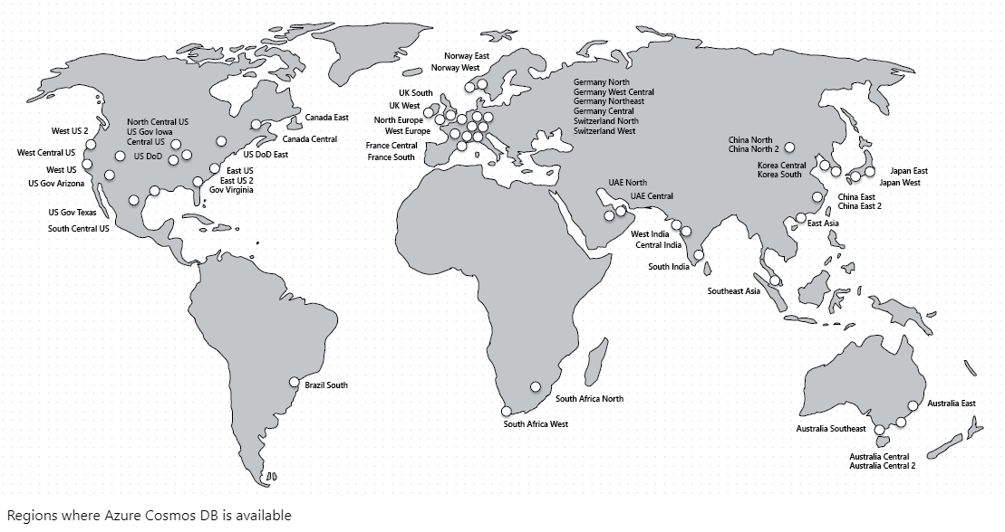
Azure Cosmos DB
A globally distributed, massively scalable, multi-model database service
Secure by default and enterprise ready
Ubiquitous regional presence
Battle tested database service
No schema or index management
Five well-defined consistency models
Elastic scale out
of storage & throughput
Guaranteed low latency at the 99th percentile
Turnkey global distribution
Comprehensive SLAs
Notes:
No schema or index management
Keeping database schema and indexes in-sync with an application’s schema is especially painful for globally distributed apps
You do not need to deal with schema or index management
Database engine is fully schema-agnostic
Automatically indexes all data
Battle tested database service
Cosmos DB is a foundational service in Azure
For nearly a decade, Cosmos DB has been used by many of Microsoft’s products for mission critical applications at global scale
Skype, Xbox, Office 365, Azure, and many others
One of the fastest growing services on Azure
Ubiquitous regional presence
Azure public cloud
Azure China 21Vianet (one of China’s largest internet providers)
Azure Germany (data remains in country)
Azure Government (4 regions)
Azure Government for Department of Defense (2 regions)
Secure by default and enterprise ready
Certified for a wide array of compliance standards
CSA STAR Certification\CSA STAR Attestation
ISO 20000-1:2011, 22301:2012, 27001:2013, 27017:2015, 27018:2014
SOC 1,2,3
DoD SRP Level 2
FedRAMP Moderate
GxP
HIPPA
HITRUST
PCI DSS
Australian IREP Unclassifed
Germany C5
Singapore MTCS Level 3
Spain ENS High
Encrypted at rest and in motion
Provides row level authorization and adheres to strict security standards

Slide 11


Azure Cosmos DB
A globally distributed, massively scalable, multi-model database service
SQL
MongoDB
Table API
Column-family
Document
Key-value
Graph
Five well-defined consistency models
Elastic scale out
of storage & throughput
Guaranteed low latency at the 99th percentile
Turnkey global distribution
Comprehensive SLAs
Notes:
Azure Cosmos DB natively supports multiple data models including <CLICK> documents, key-value, column-family, and graph.
Core content-model is based on atom-record-sequence (ARS).
Atoms consist of small set of primitive types like strings, bool, and number
Records are structures composed of these types
Sequences are arrays consisting of atoms, records, or sequences.
Database engine can efficiently translate and project different data models onto the ARS-based data model
The service also supports popular APIs for data access and querying
Currently supports SQL, MongoDB, Azure Tables, Cassandra, and Gremlin

Slide 12
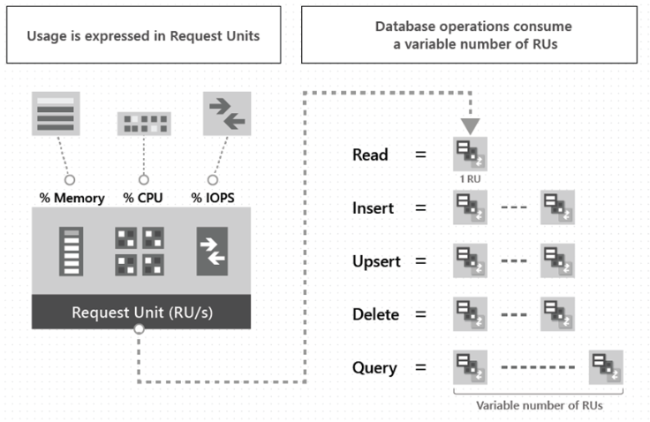
Azure Cosmos DB Request Units
Item Size
Item Indexing
Item Property Count
Indexed Properties
Data Consistency
Query Patterns
Script Usage
Notes:
Before we talk about pricing; we have to talk about Request Units
Those cost of all database operations is normalized and is expressed by Request Units (Rus for short)
Abstracts the system resources such as CPU, IOPS, and memory that are required to perform the database operations
Cost to read a 1-Kb item is 1 Request Unit; all other database operations are similarly assigned a cost using RUs
To manage and plan capacity, Azure Cosmos DB ensures that the number of RUs for a given database operation over a given dataset is deterministic. You can examine the response header to track the number of Rus that are consumed by any database operation.
Provision the number of Rus for your application on a per-second basis in increments of 100 RUs per second. Billed on an hourly basis.
Request Unit Considerations
Factors to consider when estimating the number of Rus per second to provision:
Item size
As the size of an item increases, the number of RUs consumed to read or write the item also increases
Item Indexing
By default, each item is automatically indexed. Fewer RUs are consumed if you choose not to index some of your items in a container.
Item property count
Assuming the default indexing is on all properties, the number of RUs are consumed to write an item increases as the item property count increases
Indexed properties
An index policy on each container determines which properties are indexed by default. To reduce the RU consumption for write operations, limit the number of indexed properties.
Data consistency
The strong and bounded staleness consistency levels consume approximately two times more RUs while performing read operations when compared to the other relaxed consistency levels.
Query patterns
The complexity of a query affects how many RUs are consumed for an operation. Factors that affect cost of query operation include:
Number of query results
Number of predicates
Nature of the predicates
Number of user-defined functions
Size of the source data
Size of the result set
Projections
Script usage
As with queries, stored procedures and triggers consume RUs based on the complexity of the operations that are performed.

Slide 13
Azure Cosmos DB Pricing
Unit | Price
Provisioned Throughput (multiple region writes) per 100 RU/s | $0.016/hour
Provisioned Throughput (single region writes) per 100 RU/s | $0.008/hour
SSD Storage (per GB) | $0.25 GB/month
Starts at approximately $23.61/month
Save 15-65% with Reserved Pricing
Notes:
400 RU/s = 23.36 + 0.25 for 1-Gb Storage → $23.61
20,000 RU/s + Storage
Pay as you go for 1-year: $14,016
Pay as you go for 3-year: $42,048
1-Year Reserved: $11,913.60 (2,102.40) (15%)
3-Year Reserved: $31,536.00 (10,5012) (25%)
30,000,000 RU/s + Storage
Pay as you go for 1-year: $1,752,000 x 12 = $21,024,000
Pay as you go for 3-year: $63,072,000
1-Year Reserved: $11,899,584.00 (9,124,416) (43.4%)
3-Year Reserved: $26,290,512.00 (36,781,488) (58.3%)

Slide 14



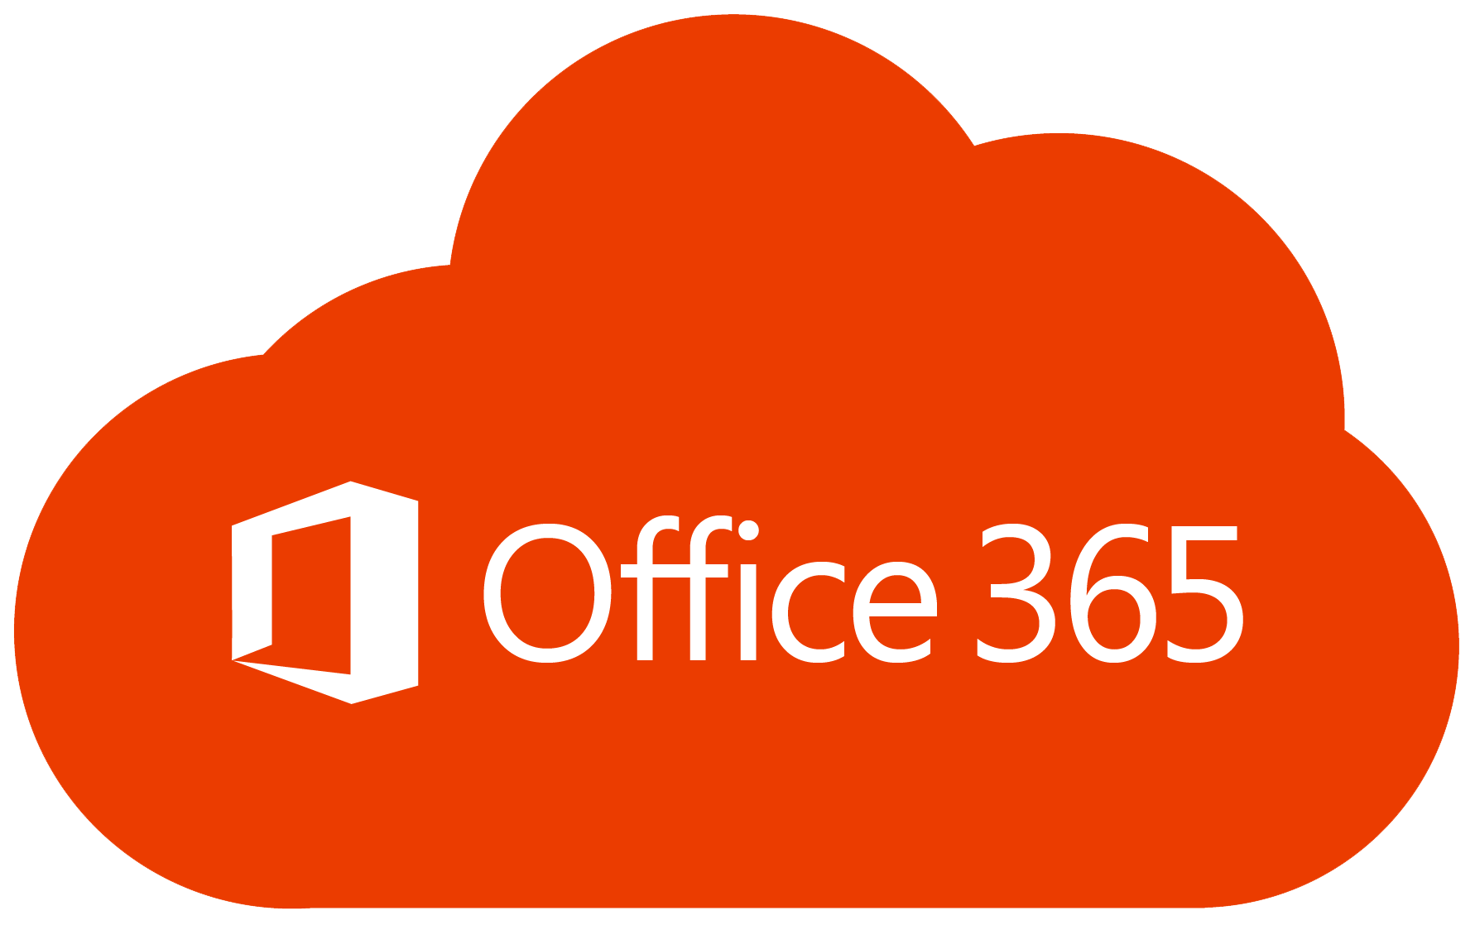

Azure Cosmos Capabilities
What if we have REALY large data requirements?

Slide 15
Azure Cosmos Capabilities
Resource | Default Limit
Maximum RUs per container | 1,000,000
Maximum RUs per database | 1,000,000
Maximum Rus per (logical) partition key | 10,000
Maximum storage across all items per (logical) partition key | 10 GB
Maximum number of distinct (logical) partition keys | Unlimited
Maximum storage per container | Unlimited
Maximum storage per database | Unlimited
Notes:
1M RUs = $8,000/hour or up to $5.952M per month
IMPORTANT: 10-Gb storage limit per logical partition key
FUNNY: Documentation for limits has “No practical limit”
Maximum length of property name/value
maximum number of properties per item
But note that the maximum size of an item is 2-Mb (UTF-8 length of JSON representation)

Slide 16

Cosmos Use Cases
Notes:
The following are some attributes of Azure Cosmos DB that make it well-suited for high-performance applications with global ambition:
Natively partitions your data for high availability and scalability and offers 99.99% guarantees for availability, throughput, low latency, and consistency on all single-region accounts and all multi-region accounts
SSD backed storage with low-latency order-of-millisecond response times
Support for consistency levels like eventual, consistent prefix, session, and bounded-staleness allows for full flexibility and low cost-to-performance ratio
Flexible data-friendly pricing model that meters storage and throughput independently
Reserved throughput model allows you to think in terms of number of reads/writes instead of CPU/memory/IOPs of the underlying hardware
Design lets you scale to massive request volumes in the order of trillions of requests per day
These attributes are beneficial in web, mobile, gaming, and IoT applications that need low response times and need to handle massive amounts of reads and writes

Slide 17
IoT and Telematics
Common Pattern in IoT use cases
Ingest bursts of data from devices and sensors of various locales
Process and analyze streaming data to derive real-time insights
Archive data to cold storage for batch analytics
Notes:
IoT use cases commonly share some patterns in how they ingest, process, and store data:
Systems need to ingest bursts of data from devices sensors of various locales
Systems process and analyze streaming data to derive real-time insights
Data is then archived to cold storage for batch analytics

Slide 18
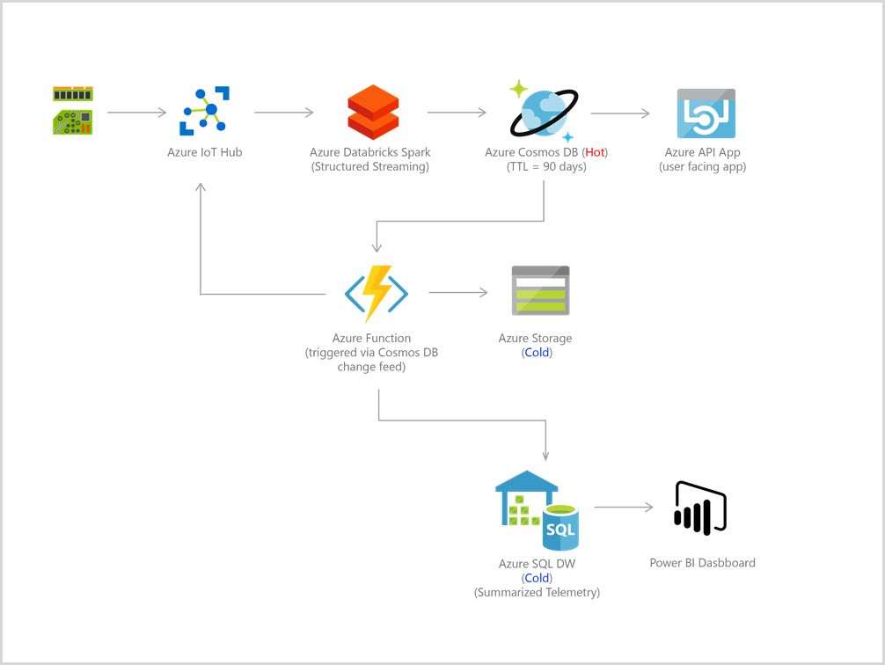
IoT and Telematics
Notes:
Bursts of data can be ingested by Azure Event Hubs as it offers high throughput data ingestion with low latency.
Data ingested that needs to be processed for real-time insight can be funneled to Azure Stream Analytics for real-time analytics.
Data can be loaded into Azure Cosmos DB for adhoc querying.
Then all data or just changes to data in Azure Cosmos DB can be used as reference data as part of real-time analytics.
In addition, data can further be refined and processed by connecting Azure Cosmos DB data to HDInsight for Pig, Hive, or Map/Reduce jobs.
Refined data is then loaded back to Azure Cosmos DB for reporting.

Slide 19
Retail and Marketing
Used extensively by Microsoft’s own e-commerce platforms
Storing and querying a set of attributes for entities
Examples of catalog data
User Accounts
Product Catalogs
IoT Device Registries
Notes:
Azure Cosmos DB is used extensively in Microsoft’s own e-commerce platforms behind the Windows Store and Xbox Live.
Catalog data usage scenarios involve storing and querying a set of attributes for entities such as people, places, and products.
Some examples of catalog data are user accounts, product catalogs, IoT device registries, and bill of materials systems.

Slide 20
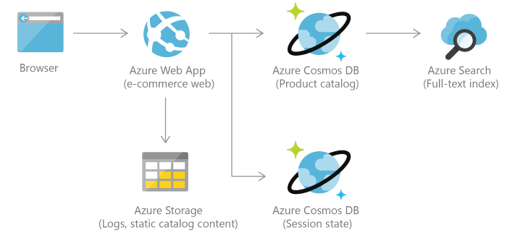
Retail and Marketing
Notes:
Consider an example of a product catalog for an automotive parts supplier. Every part may have its own attributes in addition to the common attributes that all parts share. Furthermore, attributes for a specific part can change the following year when a new model is released. Azure Cosmos DB supports flexible schemas and hierarchical data, and thus it is well suited for storing product catalog data.

Slide 21
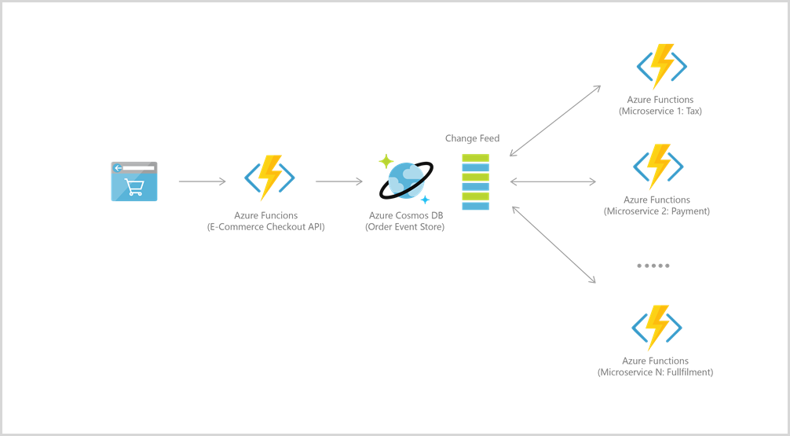
Retail and Marketing
Notes:
Azure Cosmos DB is often used for event sourcing to power event driven architectures using its change feed functionality. The change feed provides downstream microservices the ability to reliably and incrementally read inserts and updates (for example, order events) made to an Azure Cosmos DB. This functionality can be leveraged to provide a persistent event store as a message broker for state-changing events and drive order processing workflow between many microservices (which can be implemented as serverless Azure Functions).

Slide 22


Gaming
Database tier is crucial
Often require single-millisecond latencies for reads and writes
Needs to be fast and able to handle massive spikes
Notes:
The database tier is a crucial component of gaming applications. Modern games perform graphical processing on mobile/console clients, but rely on the cloud to deliver customized and personalized content like in-game states, social media integration, and high-score leaderboards.
Games often require single-millisecond latencies for reads and writes to provide an engaging in-game experience
A game engine needs to be fast and able to handle massive spikes in request rates during new game launches and feature updates.
Examples of games using Cosmos:
The Walking Dead: No Man’s Land
Halo 5: Guardians

Slide 23
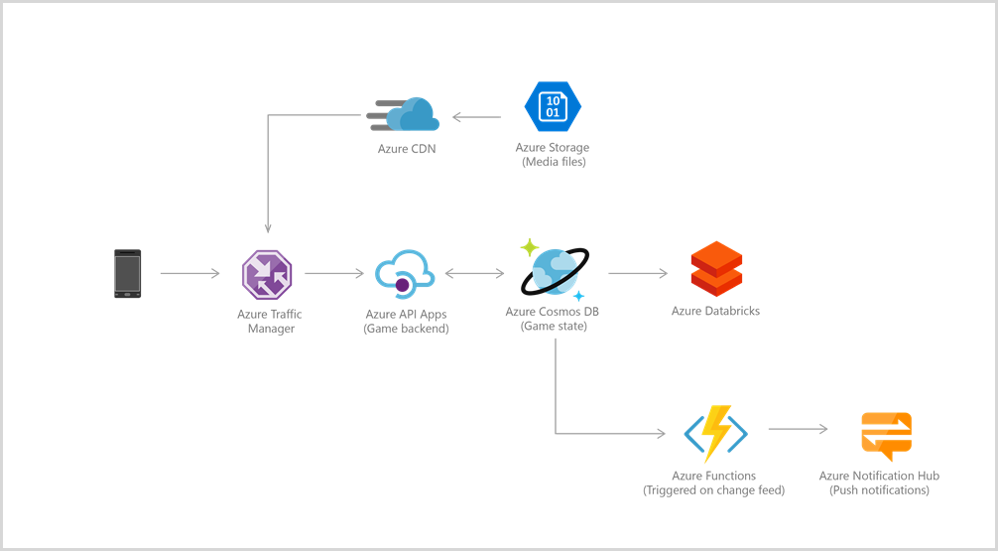
Gaming
Notes:
Azure Cosmos DB Change Feed → Azure Function → Azure Notification Hub

Slide 24
Web & Mobile Applications
Modeling social interactions
Integrating with third-party services
Building rich personalized experiences
Notes:
Commonly used within web and mobile applications, and is well suited for modeling social interactions, integrating with third-party services, and building rich personalized experiences.
Two very common use cases are Social Applications and Personalization

Slide 25
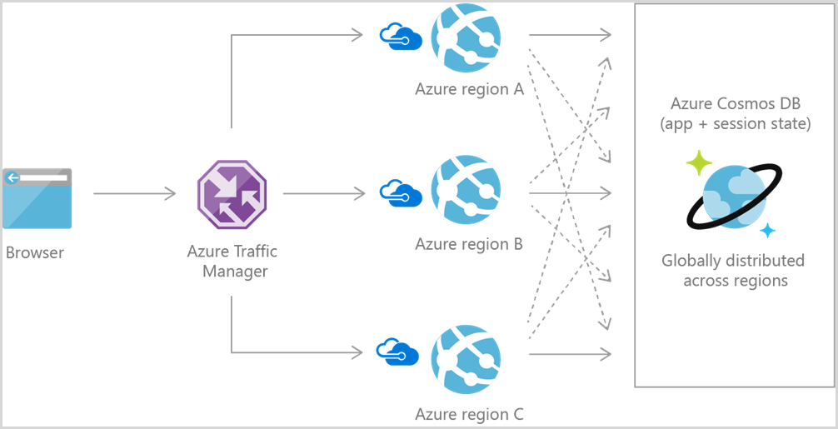
Web & Mobile Applications – Social Applications
Notes:
Common use case for Azure Cosmos DB is to store and query user generated content for web, mobile, and social media applications
Examples are chat sessions, tweets, blog posts, ratings, and comments.
Most social applications run at global scale and can exhibit unpredictable usage patterns. Flexibility in scaling the data store is essential as application layer scales to match usage demand.
You can create additional Cosmos DB accounts across multiple regions.

Slide 26
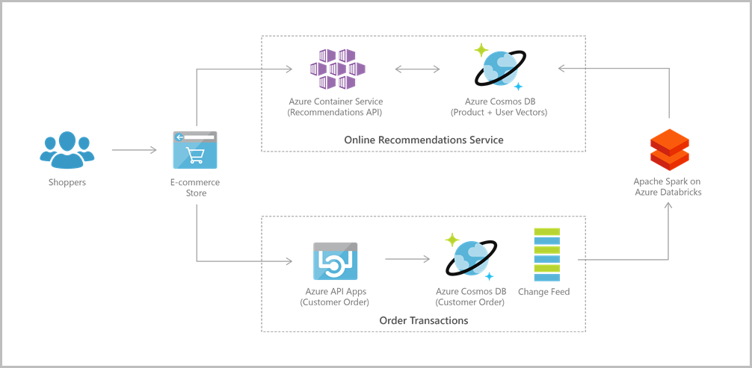
Web & Mobile Applications – Personalization
Notes:
Applications come with complex views and experiences.
These are typically dynamic, catering to user preferences or moods and branding needs.
Hence, applications need to be able to retrieve personalized settings effectively to render UI elements and experiences quickly.

Slide 27

Integrations
Notes:
One last thing before talking about the 5 API models

Slide 28






Cosmos DB Integrations
Azure Logic Apps
Azure Functions
Change Feed
Microsoft Flow
Apache Spark
Etch API
Notes:
Apache Spark – Use the built-in support for Apache Spark to run analytics on the data stored in an Azure Cosmos account

Slide 29






Navigating the 5 API Models

Slide 30
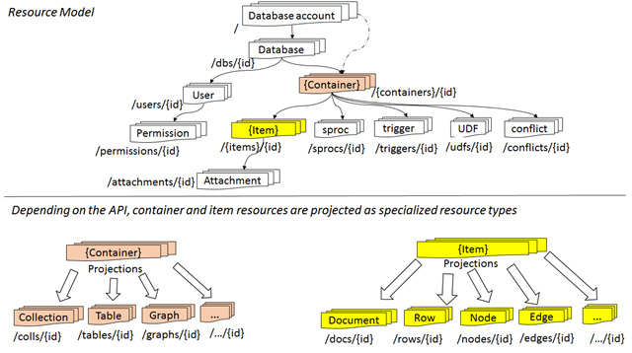
Resource Model and API Projections
Atom
Resource
Sequence
Notes:
Each resource is uniquely identified by a stable and logical URI and represented as a JSON document.
The overall resource model of an application using Azure Cosmos DB is a hierarchical overlay of the resources rooted under the database account, and can be navigated using hyperlinks.
<CLICK>
The content model of the item resource is based on atom-record-sequence (ARS). Both, container and item resources are further projected as reified resource types for a specific type of API interface. For example, while using document-oriented APIs, container and item resources are projected as collection (container) and document (item) resources, respectively; likewise, for graph-oriented API access, the underlying container and item resources are projected as graph (container), node (item) and edge (item) resources respectively; while accessing using a key-value API, table (container) and item/row (item) are projected.
Azure Cosmos DB uses an atom-record-sequence (ARS) system. Basically, the Cosmos DB translates all data models into atom-record-sequence based models.
So, everything becomes either an atom, a record or a sequence.
An atom is a primitive type.
A record is a struct
A sequence is an array of either atoms, records or structs.

Slide 31
SQL API
Document Database

Slide 32
SQL API – What
Document Database
Originally Microsoft’s DocumentDB implementation
Supports using SQL as a JSON query language
Uses JavaScript’s programming model as foundation for query language
Notes:
The Cosmos DB SQL API supports querying items using Structured Query Language (SQL) as a JSON query language.
The design goals of the query language are to:
Support SQL, one of the most familiar and popular query languages, instead of investing a new query language. SQL provides a formal programming model for rich queries over JSON items.
Use JavaScript’s programming model as the foundation for the query language.
JavaScript’s type system, expressive evaluation, and function invocation are the roots of the SQL API.
These roots provide a natural programming model for features like relational projections, hierarchical navigation across JSON items, self-joins, spatial queries, and invocation of user-defined functions written entirely in JavaScript

Slide 33
SQL API – Why
Building a new non-relational document database and want to query using SQL
Notes:
Use the SQL API if you are building a new non-relational document database and want to query using familiar SQL syntax.

Slide 34
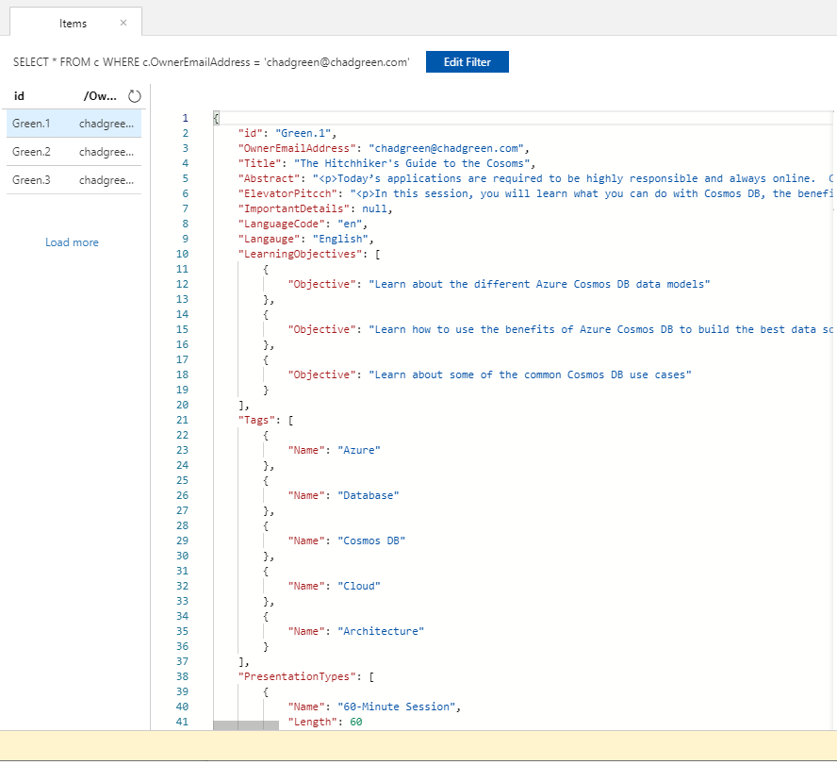
SQL API – How: Data Model
SELECT * FROM c
WHERE c.OwnerEmailAddress = ‘chadgreen@chadgreen.com’

Slide 35
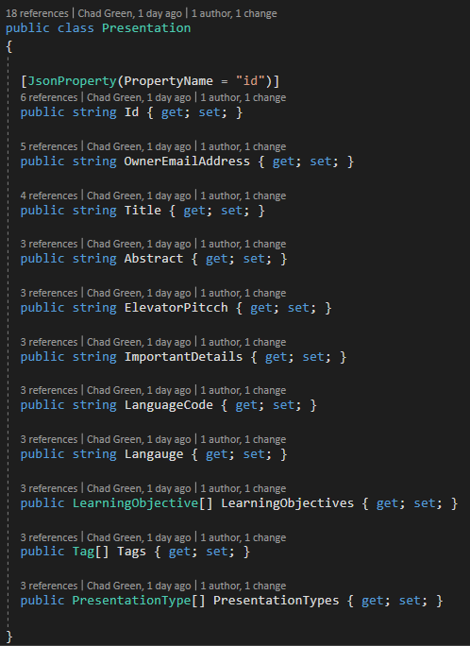
SQL API – How: Insert
Notes:
Point out the JsonProperty - PropertyName

Slide 36
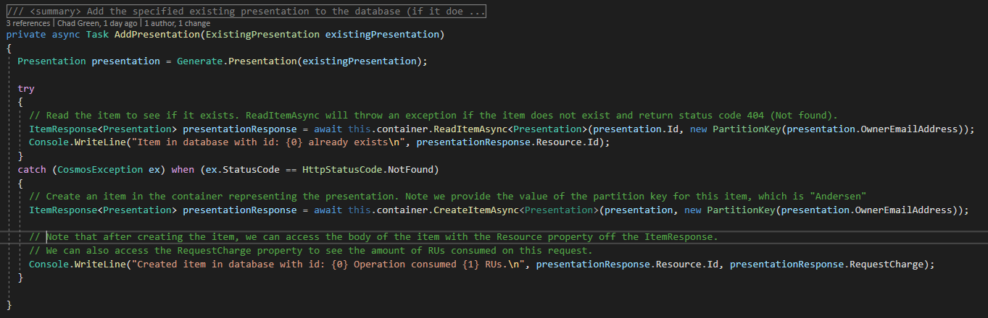
SQL API – How: Insert
Notes:
Try and read the document; will get an 404 if not present
If fail; create the item
Can get the number of RUs consumed for the operation

Slide 37
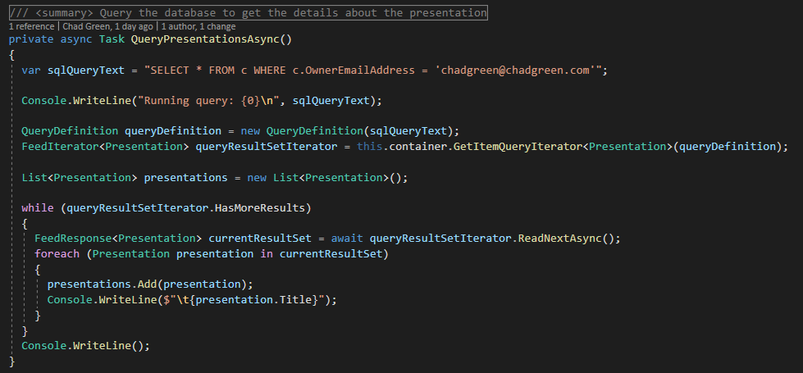
SQL API – How: Query

Slide 38
SQL API – Query
API (using Microsoft.Azure.Cosmos)
LINQ to SQL API
JavaScript
Stored Procedures
Triggers
User Defined Functions
Entity Framework
Notes:
Entity Framework introduced with Entity Framework Core 2.2

Slide 39
MongoDB
Document Database

Slide 40
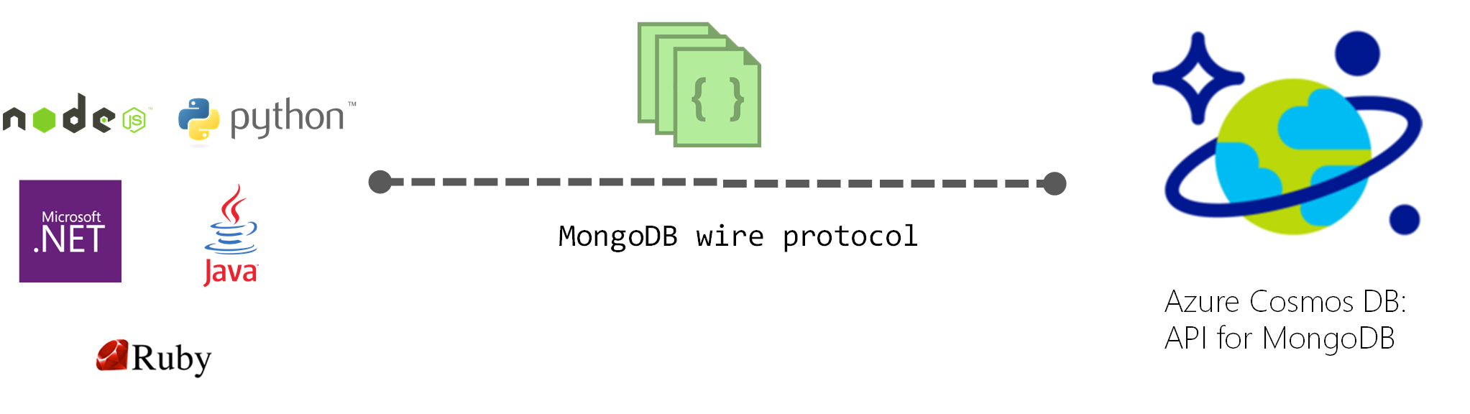
API for MongoDB – What
Native MongoDB implementation
Allows existing client SDKs, drivers, and tools to interact transparently
Default is Mongo v3.2; v3.4 in preview
Notes:
Provides a native implementation of the wire protocols directly and efficiently inside Cosmos DB, it allows existing client SDKs, drivers, and tools to intact transparently
By default, compatible with Mongo version 3.2 wire protocol
Mongo 3.4 currently available as preview
Any MongoDB client driver that understands these protocol versions should be able to natively connect

Slide 41
API for MongoDB – Why
Migrating data from a MongoDB database to Azure Cosmos DB’s fully managed service
Notes:
Easily migrate your application to Cosmos DB while preserving significant portions of your application logic
Keep your application portable and continue to remain cloud vendor-agnostic
Get industry leading, financially backed SLAs for the common NoSQL APIs powered by Cosmos DB
Elastically scale the provisioned throughput and storage based on your need and pay only for the throughput and storage you need – significant cost savings
Turnkey, global distribution with multi-master replication

Slide 42
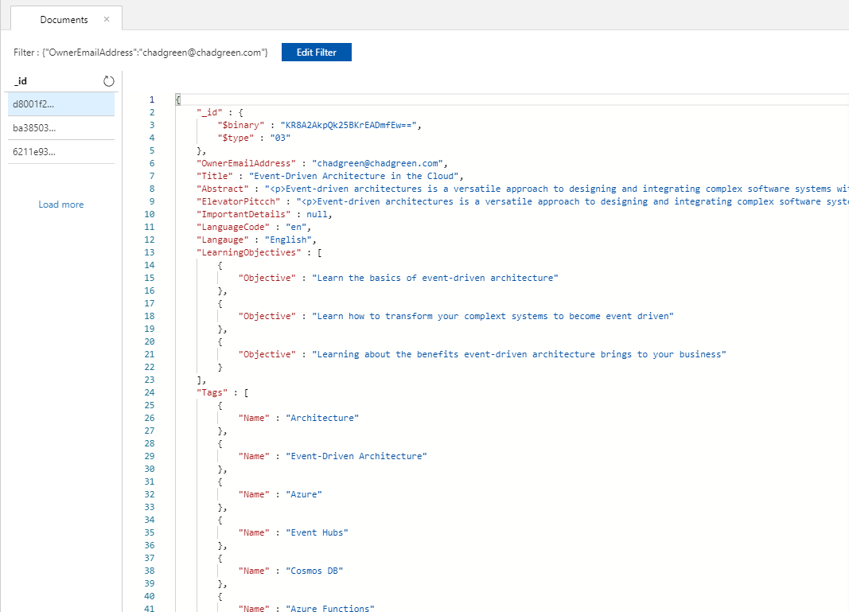
API for MongoDB – How: Data Model
Filter: {"OwnerEmailAddress":
"chadgreen@chadgreen.com"}

Slide 43
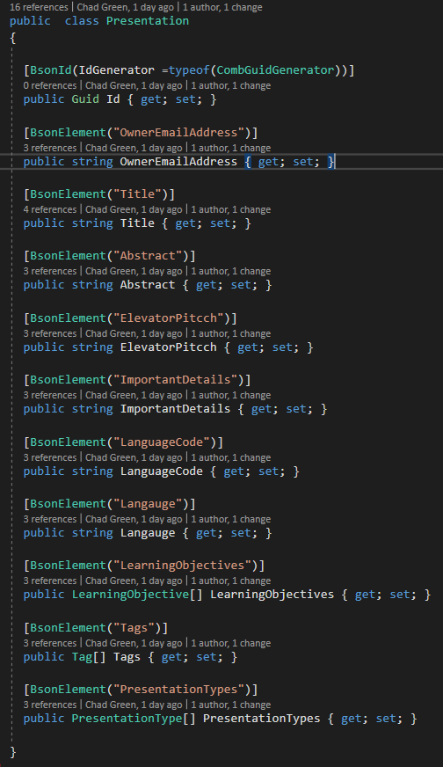
API for MongoDB – How: Insert
Notes:
BsonId
BsonElement

Slide 44
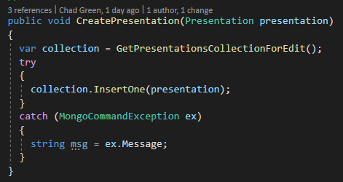
API for MongoDB – How: Insert

Slide 45
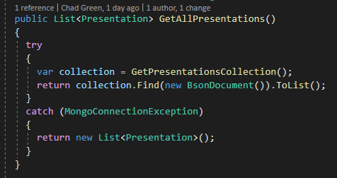
API for MongoDB – How: Query

Slide 46
Gremlin API
Graph Database

Slide 47
Gremlin API – What
Collection of vertices and edges
Represents entities as vertices and the ways in which those entities relate to the world as relationships
Allows us to model all kinds of scenarios
Notes:
Formally, a graph is just a collection of vertices and edges – or, in less formal language, a set of nodes and the relationships that connect them.
Graphs represent entities as vertices and the ways in which those entities relate to the world as relationships (or edges).
This general-purpose, expressive structure allows us to model all kinds of scenarios

Slide 48
Gremlin API – What

Slide 49
Gremlin API – Why
Building a graph database to model and traverse relationships among entities

Slide 50
Gremlin API – Why
Represent data as it is found in nature
Social Networks
Search
Recommendations
Communication networks
Identity and access management
Fraud detection
Notes:
Social Networks – Facebook; Twitter
Recommendations – Amazon
Search – Google?; many other examples
Identity and access management – Microsoft Graph
Communication networks – Map entire communications or IT networks and start to run complex scenario testing to prepare for outages better
Fraud detection – can spot the connections between large data sets and identify patterns

Slide 51
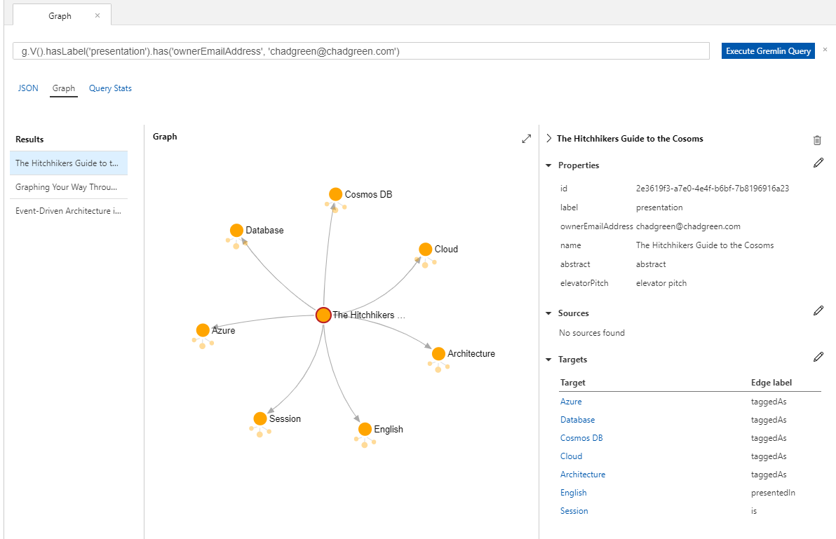
Gremlin API – How: Data Model
g.V().hasLabel
(‘presentation’)
.has(‘ownerEmailAddress’, ‘chadgreen@chadgreen.com’)

Slide 52
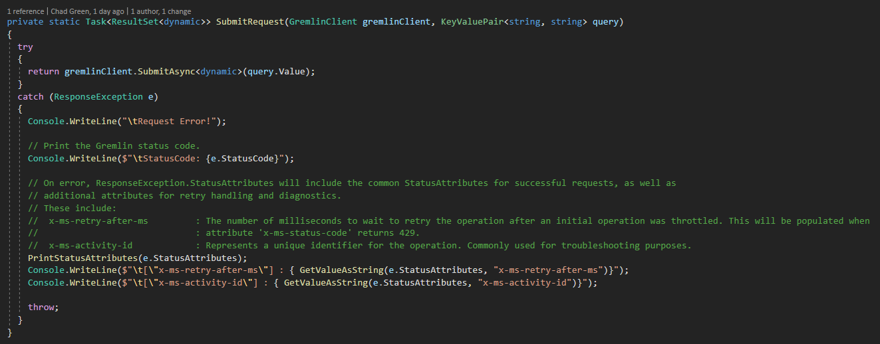
Gremlin API – How: Insert

Slide 53
Gremlin API – How: Query
"g.V()
.hasLabel('tag’)
.has('name’, 'Azure’)
.in('taggedAs’)
.hasLabel('presentation')"

Slide 54
Gremlin API – Query
API (using Gremlin.Net)
Community API (Gremlin.Net.CosmosDb)
JavaScript
Stored Procedures
Triggers
User Defined Functions
SQL API

Slide 55
Cassandra API
Wide Column Store

Slide 56
Cassandra API – What
Open-source, distributed, wide column store, NoSQL database
Designed to handle large amounts of data
Uses many commodity servers, providing high availability
Developed to power the Facebook inbox search feature
Notes:
Apache Cassandra is a free and open-sourced, distributed, wide column store, NoSQL database management system designed to handle large amounts of data across many commodity servers, providing high availability with no single point of failure.
Wide column store – uses tables, rows, and columns, but unlike a relational database, the names and formats of the columns can very from row to row in the same table. – can be interpreted as a two-dimensioned key-value store

Slide 57
Casandra API – Why
Migrating data from Cassandra to Azure Cosmos DB

Slide 58
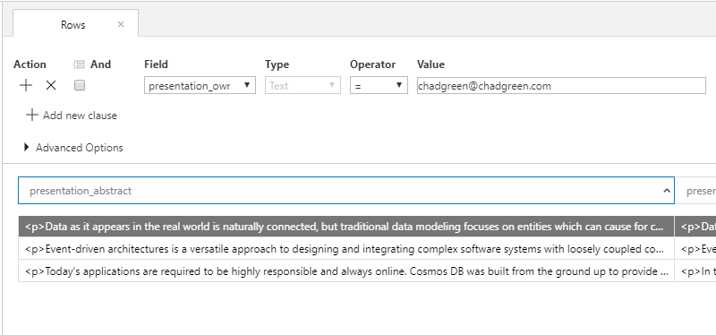
Cassandra API – How: Data Model

Slide 59
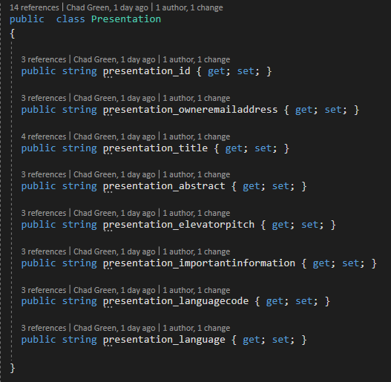
Cassandra API – How: Insert

Slide 60
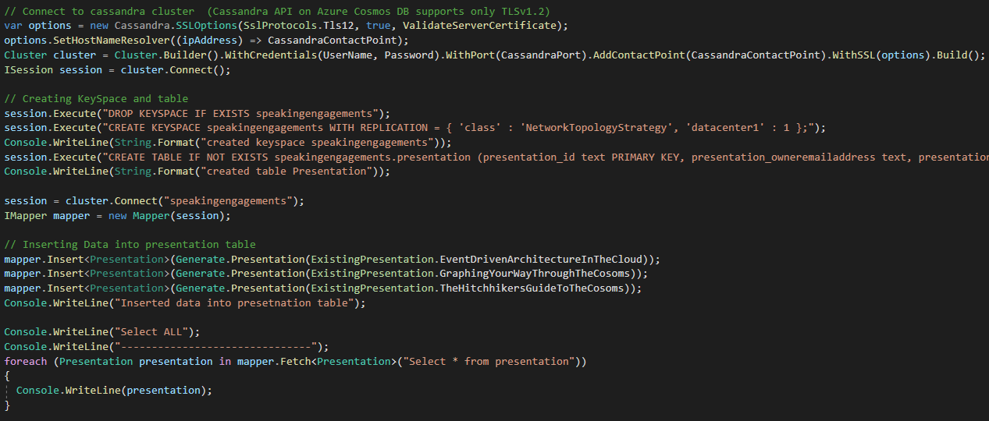
Cassandra API – How: Insert

Slide 61
Cassandra API – How: Query

Slide 62
Cassandra API – Query
API (using CassandraCSharpDriver)
Cassandra Query Language (CQL)
Cassandra-based tools (like cqlsh)

Slide 63
Table API
Table Storage

Slide 64
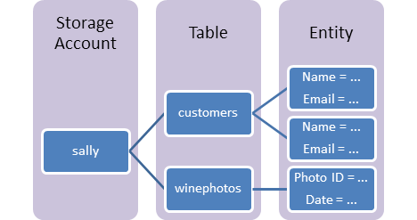
Table API – What
Stores large amounts of structured data
Ideal for storing structured, non-relational data
Notes:
Common uses:
Storing TBs of structured data capable of serving web scale applications
Storing datasets that do not require complex joins, foreign keys, or stored procedures and be denormalized for fast access
Quickly querying data using a clustered index
Accessing data using the OData protocol and LINQ queries

Slide 65
Table API – Why
Migrating data from Azure Table storage to Cosmos DB

Slide 66
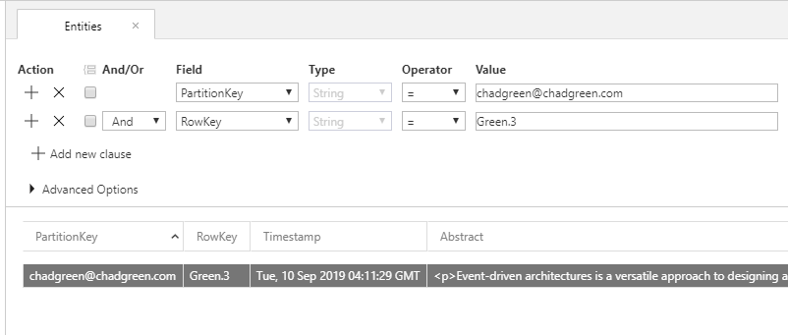
Table API – How: Data Model

Slide 67
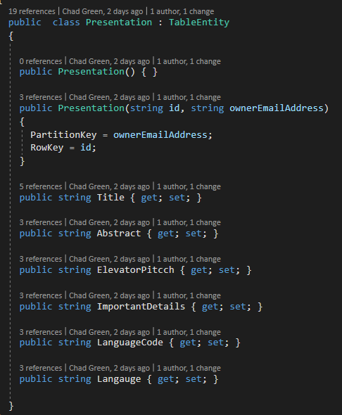
Table API – How: Insert

Slide 68
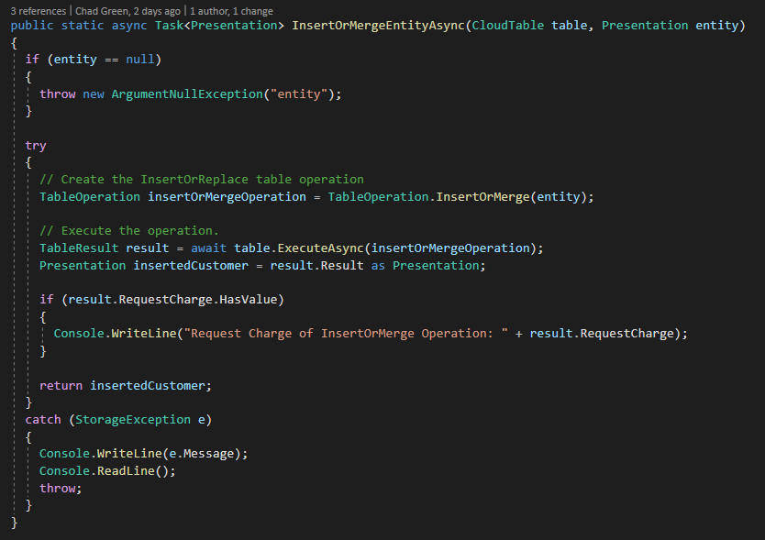
Table API – How: Insert

Slide 69
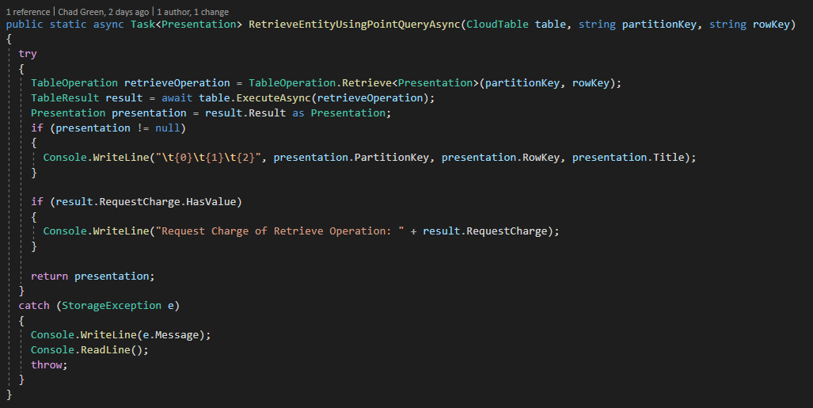
Table API – How: Query

Slide 70

Call to Action
Notes:
One last thing before talking about the 5 API models

Slide 71
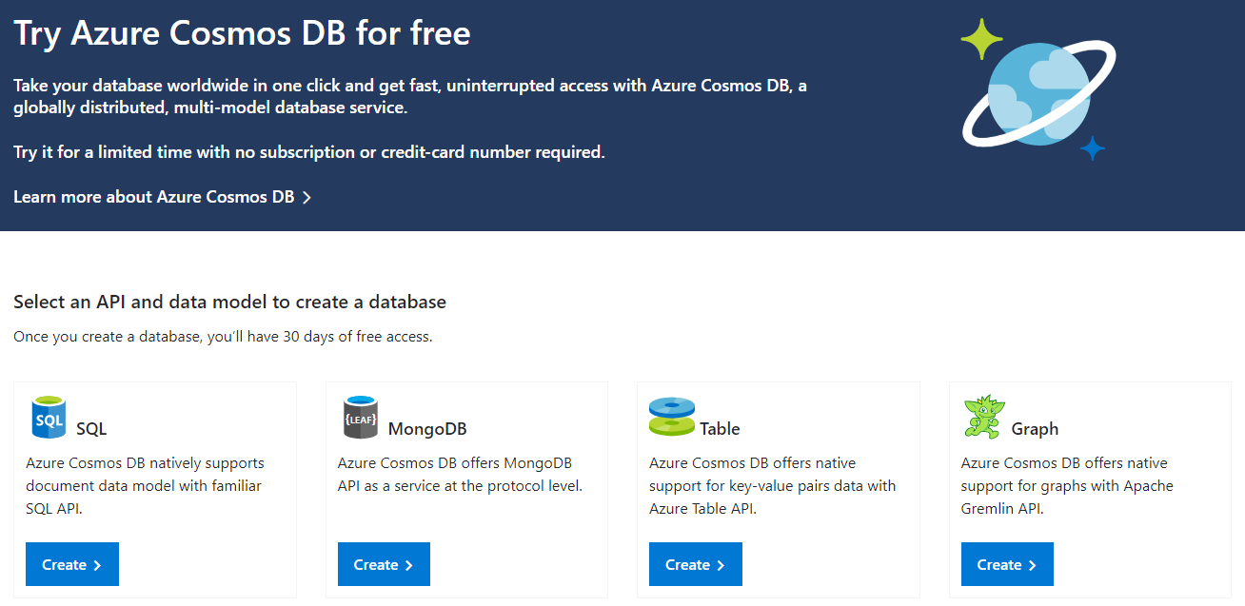
azure.microsoft.com/en-us/try/cosmosdb/

Slide 72

Thank You
→ chadgreen@chadgreen.com
 chadgreen.com
 ChadGreen
↑ ChadwickEGreen

